Slide 1


SAP UI5 & FIORI with OData TRAINING using BAS
Anubhav Oberoy
Day – 22

Slide 2

Agenda – Day 21
Introduction to Function Import
Creating a Function to get Most expensive product
Basics of Connectivity
Introduction to Cloud Connector
Steps to Setup the Cloud Connection.
Creating the destination in the BTP for BAS
Creating the destination in the Vscode

Slide 3
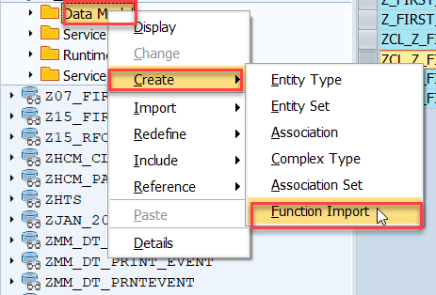
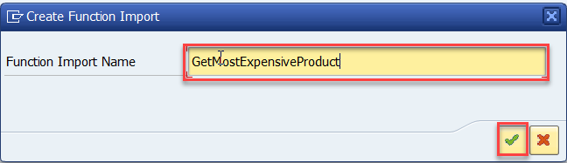
Function Import
At times, we need to implement the logic inside of OData which is not a direct CRUD operation e.g. calling a workflow, calling a BAPI which does some processing, Sending request to another server and can be invoked by the HTTP methods GET or POST .
For example: we can create the function import to GetMostExpensiveProduct in our Product set by the Category.
Step1: Right click the Data Model folder and select Create and then select Function Import. Create Function Import dialog opens

Slide 4
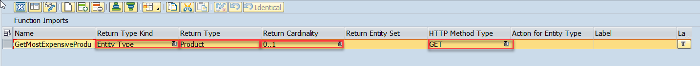
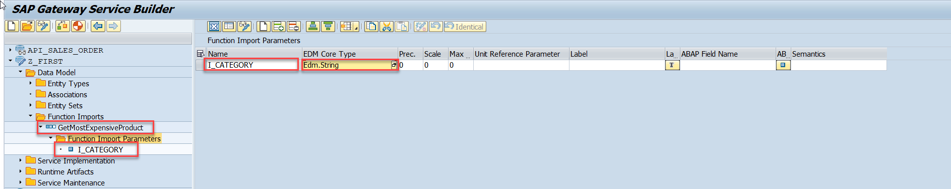
Function Import
Step2: Enter return type kind, return type, return cardinality & HTTP method Type
Step3: Giving function import parameters (I_CATEGORY)

Slide 5
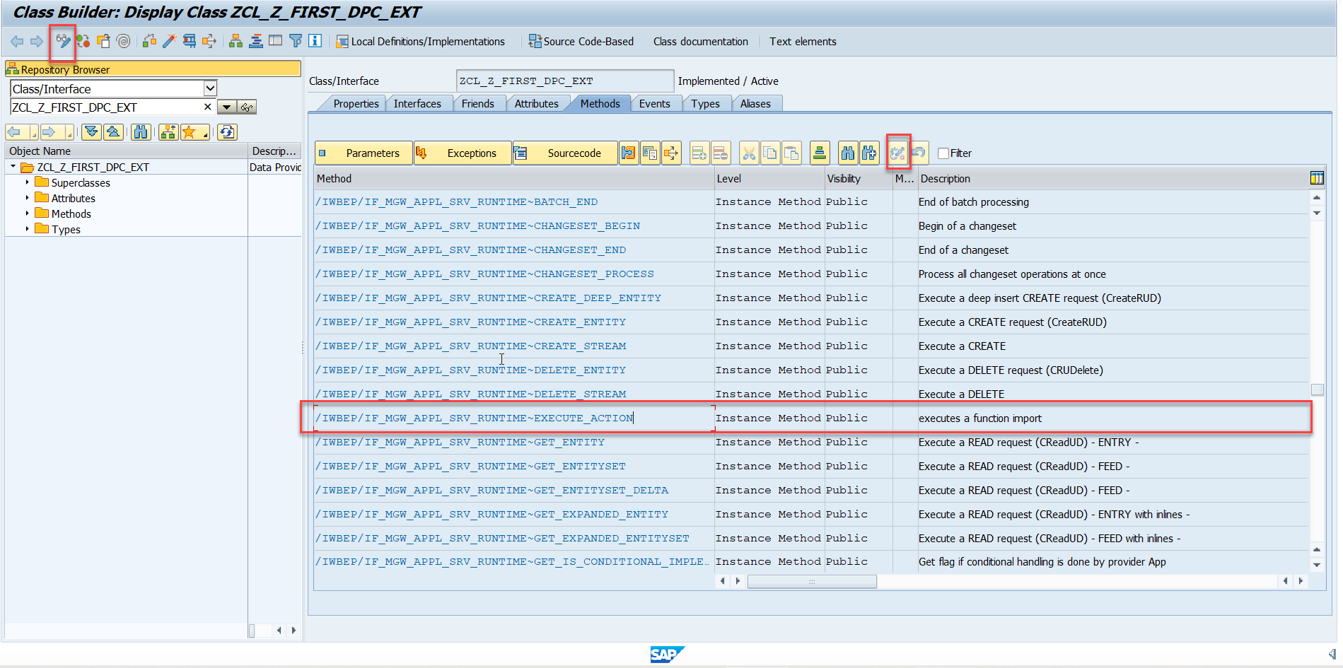
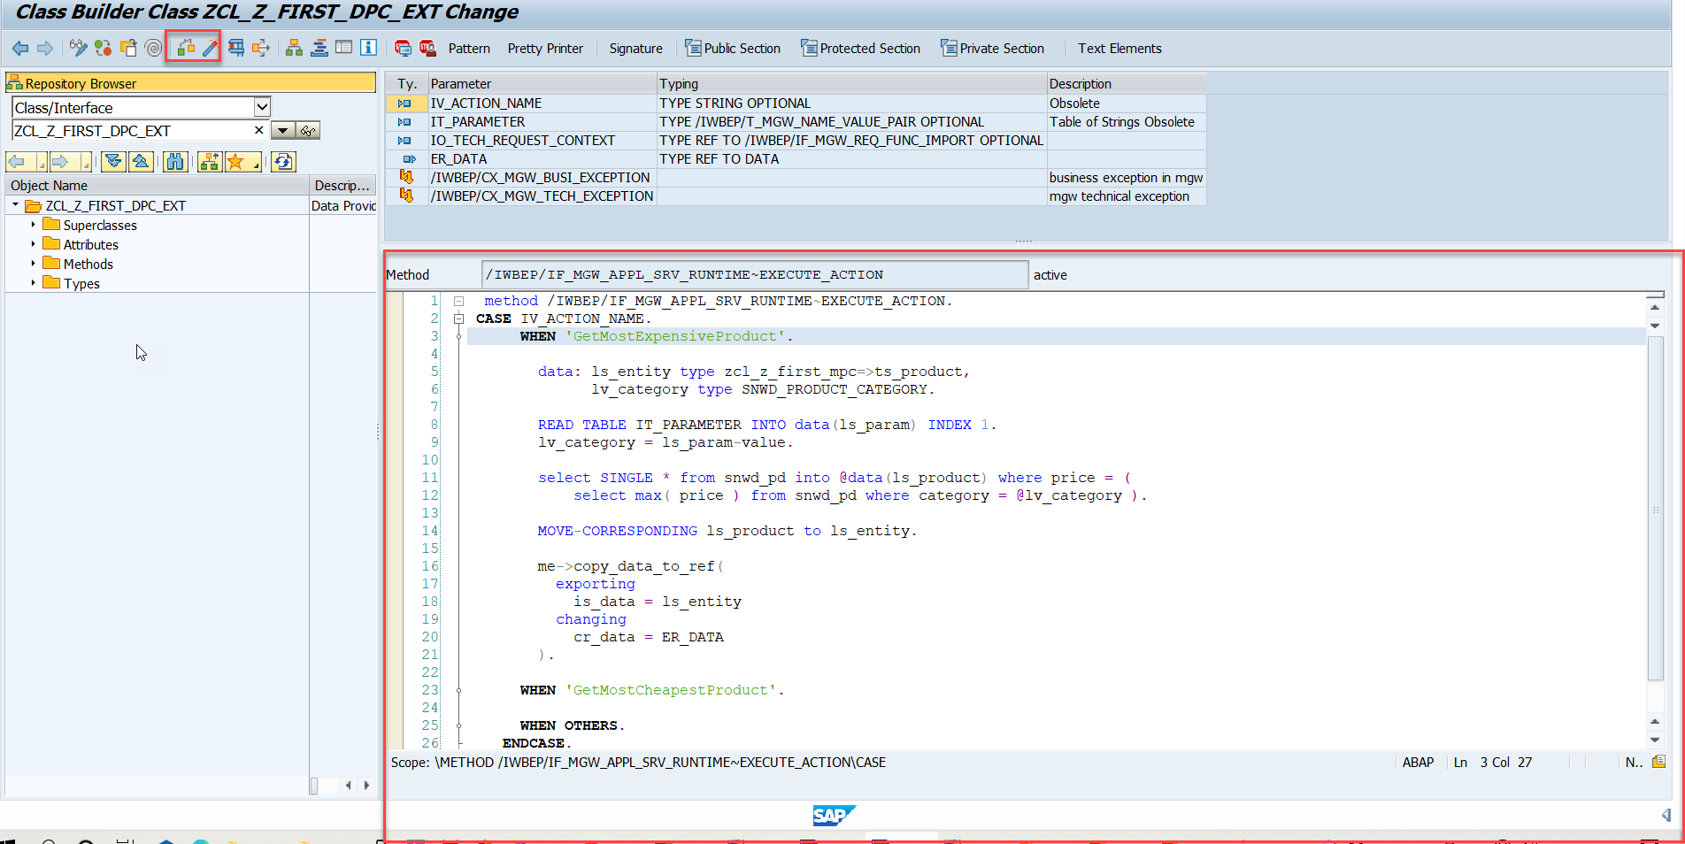
Function Import
Step4: Go to DPC Extension and search for the method--/IWBEP/IF_MGW_APPL_SRV_RUNTIME~EXECUTE_ACTION and redefine the class method
Function Import Code: funciton_import

Slide 6

Basics of Connectivity and Role of SCC
Internet
Intranet
SAP BW
SAP ECC
SAP S/4 Hana
SAP BTP (PublicCloud)
SAP Cloud Connector
SAP On-premise System
SAP Business Application Studio
SCC
Destination
S/4 Hana Cloud
Field Glass
Sales Force

Slide 7
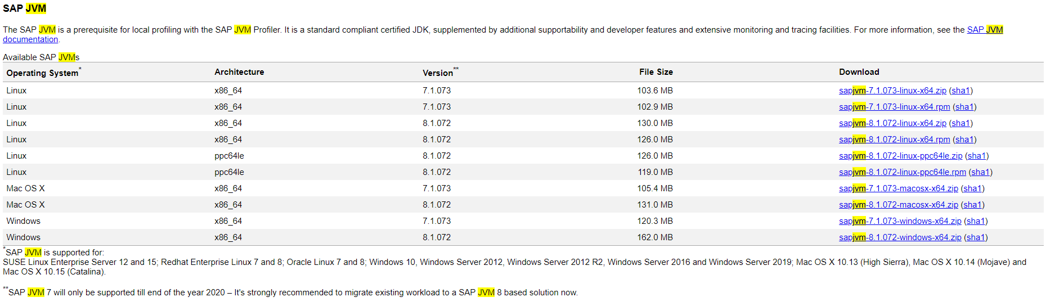
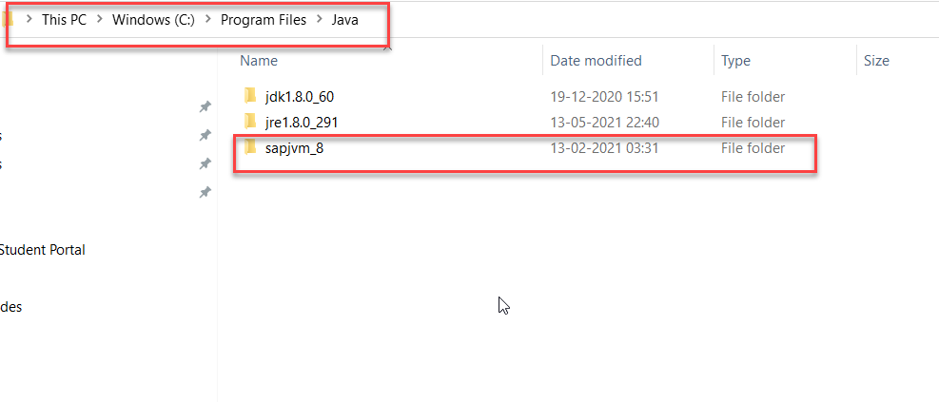
Cloud Connector
Step 1: Download SAP JVM and Extract it in the C:\Program Files\Java

Slide 8
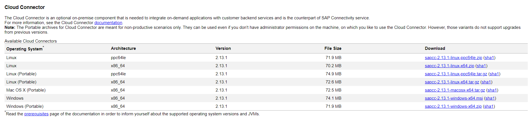
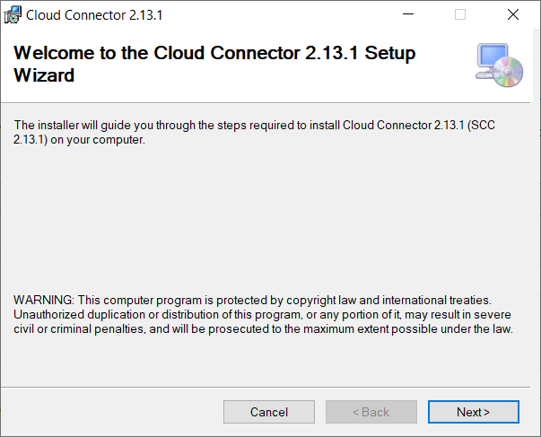
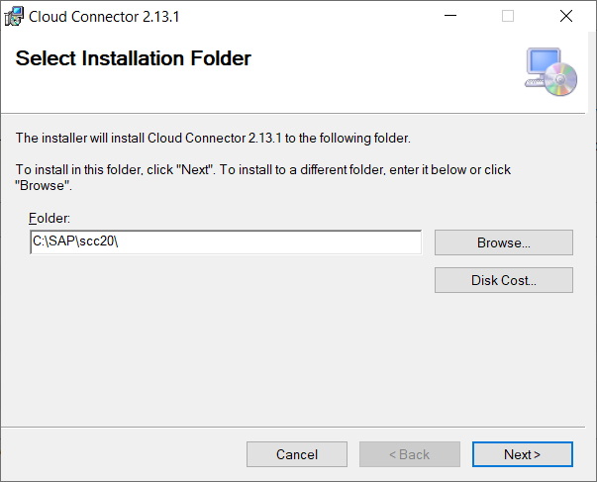
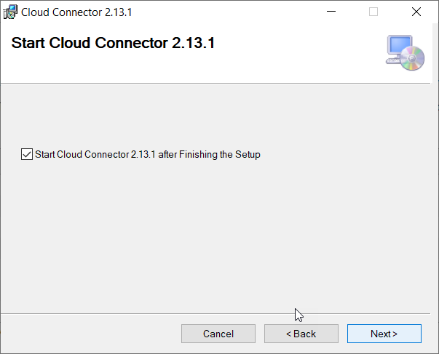
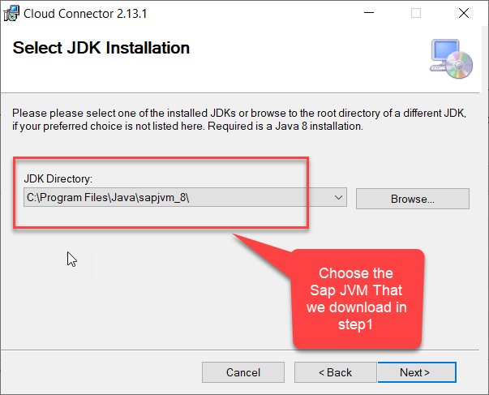
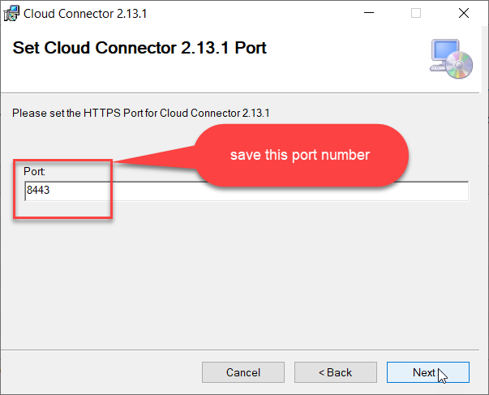
Cloud connector continue…
Step 2: Download and install the sap Cloud connector

Slide 9
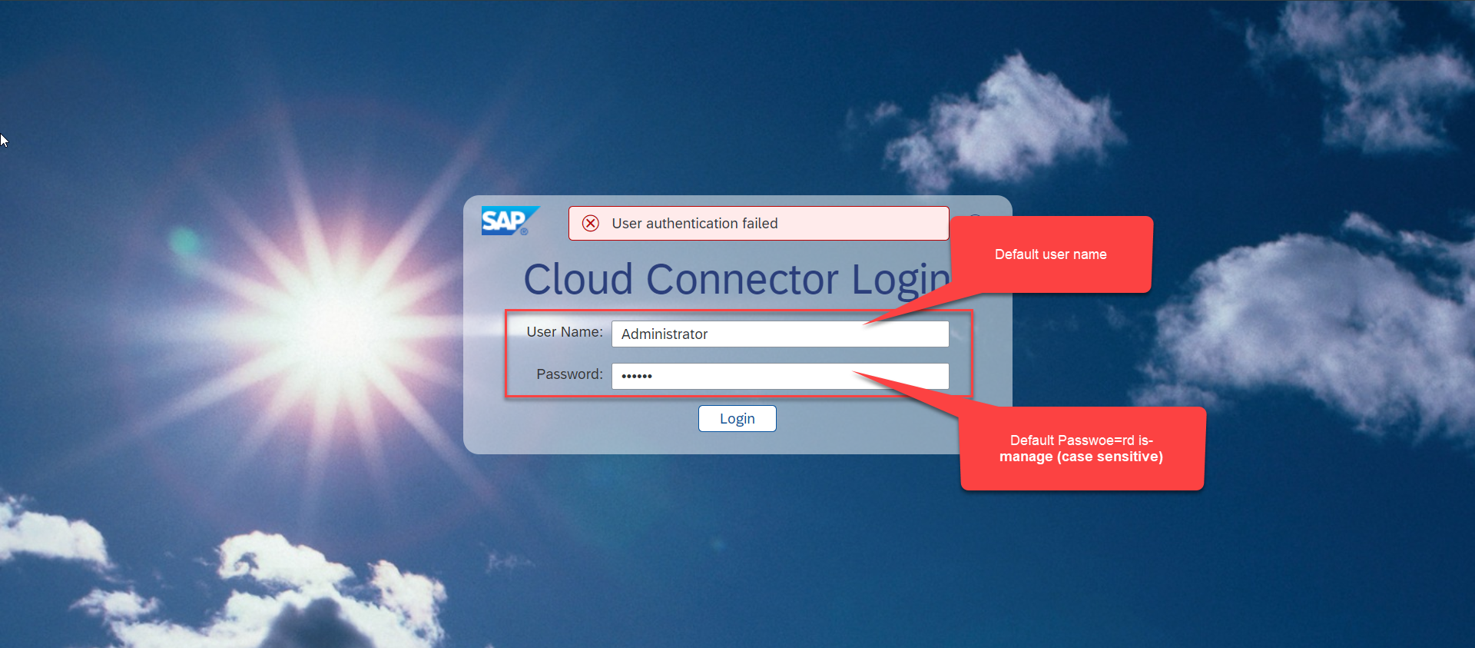
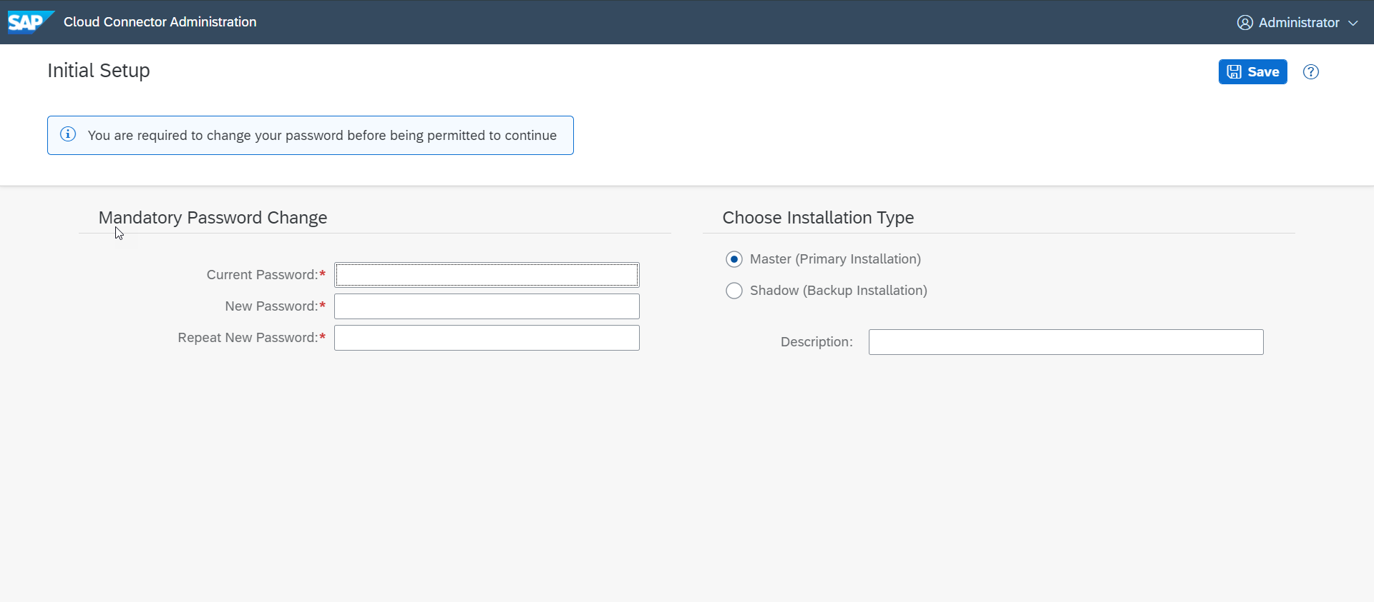
Cloud connector continue…
Step 3: Now your system is ready go to browser and open https://localhost:8443 (port may changes)
The default credentials are Administrator / manage

Slide 10
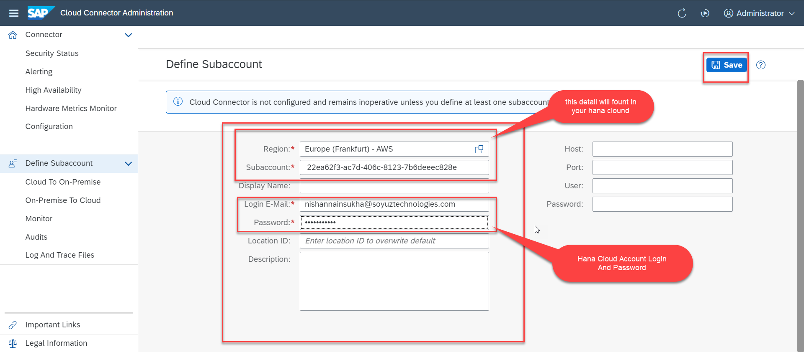
Cloud connector continue…
Step 4: Now we create a connection with our Cloud Account

Slide 11
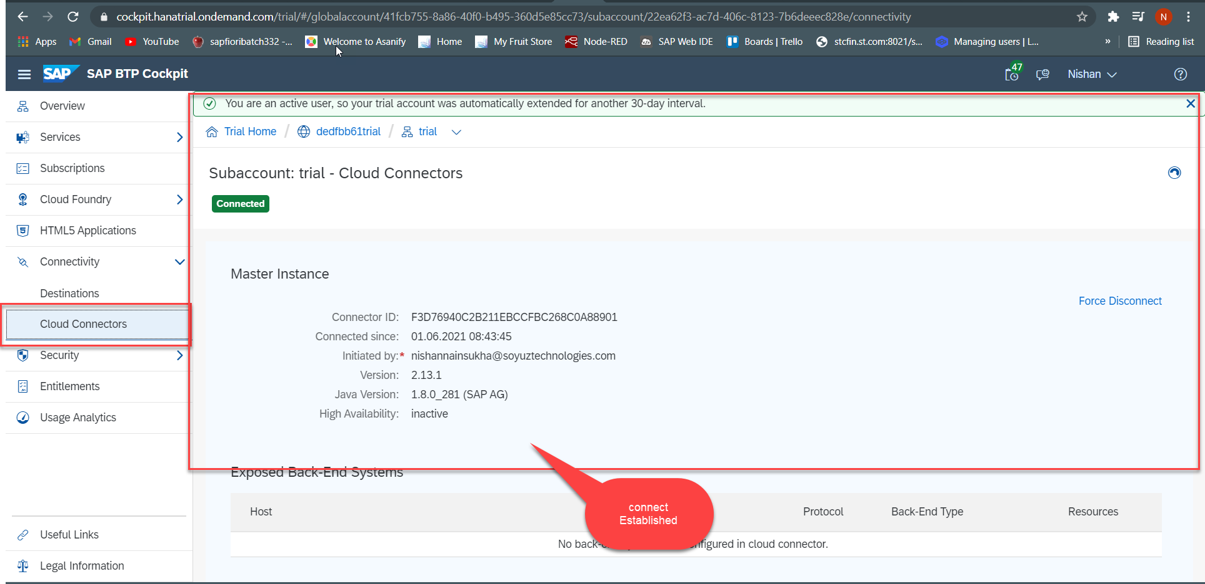
Cloud connector continue…
Step 5: Check the connection on Hana Cloud Account

Slide 12
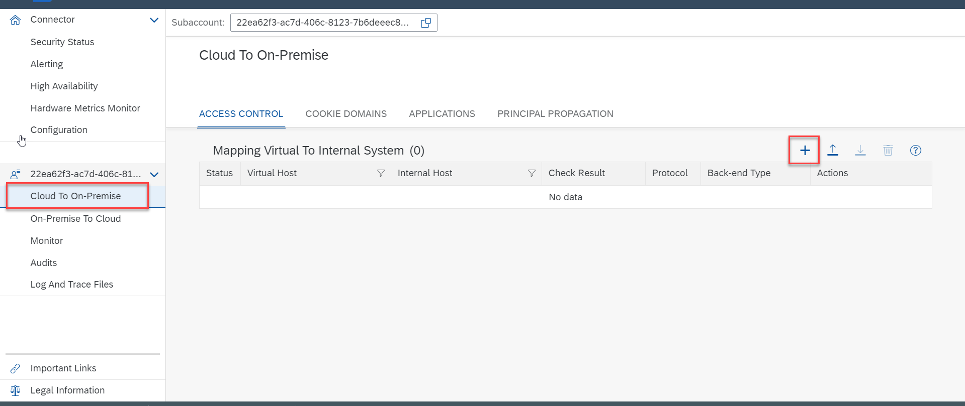
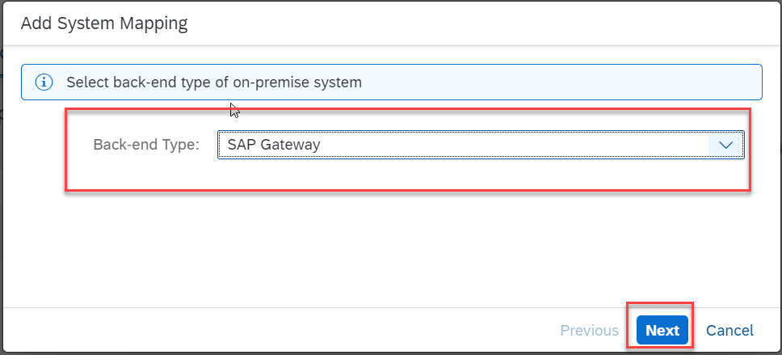
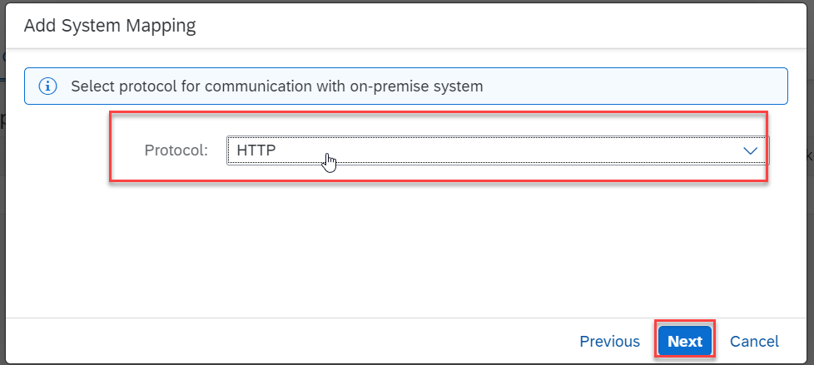
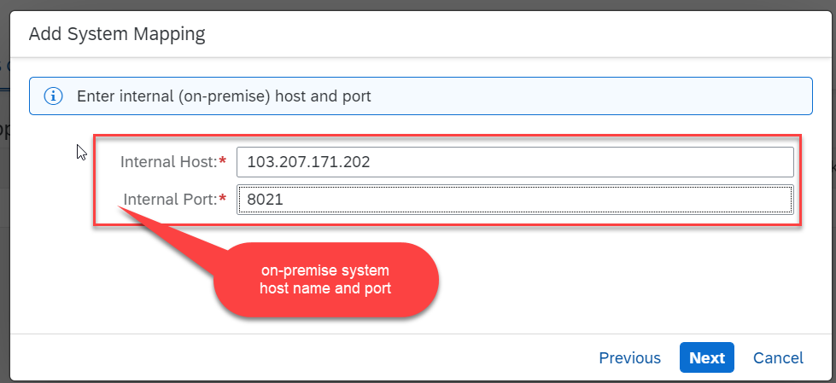
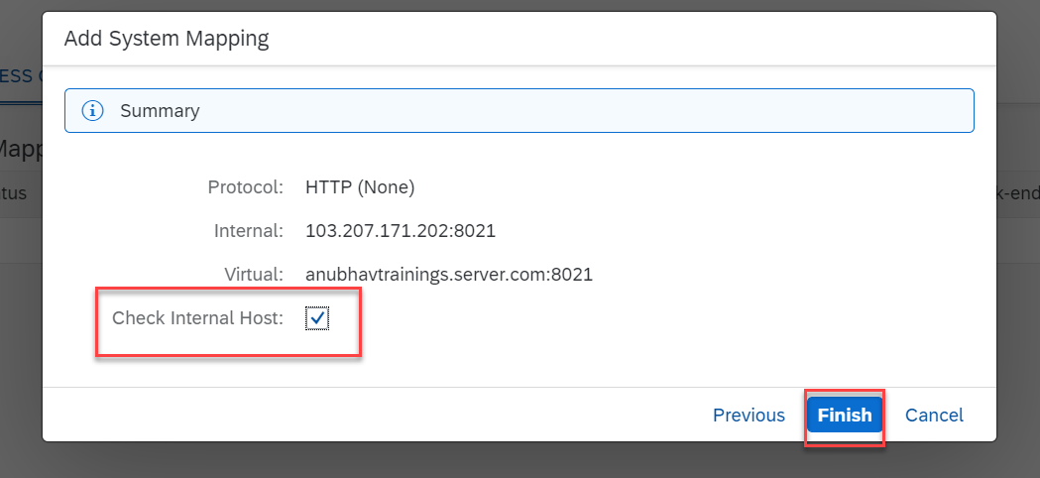
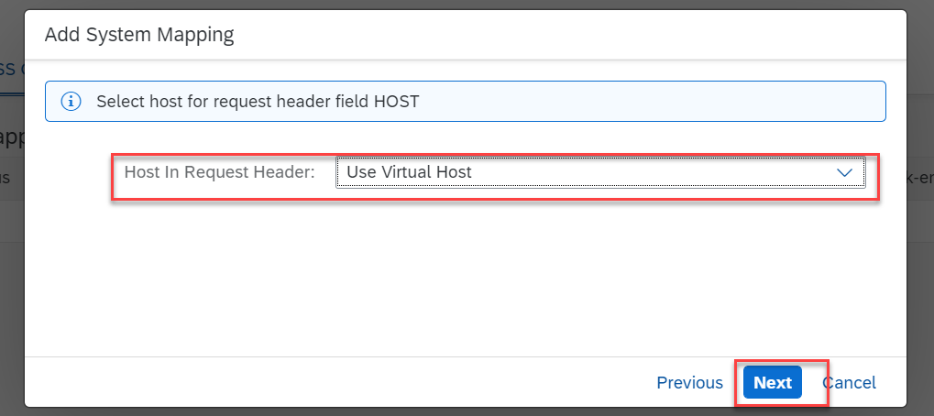
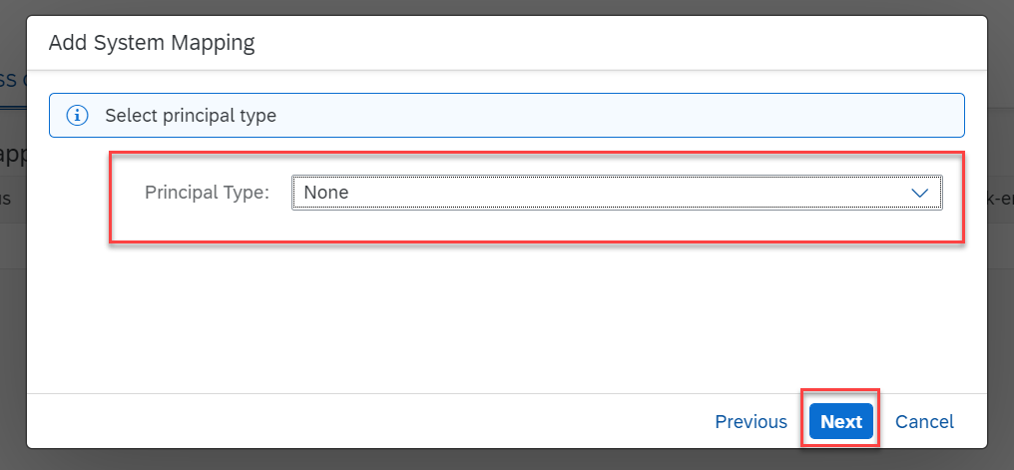
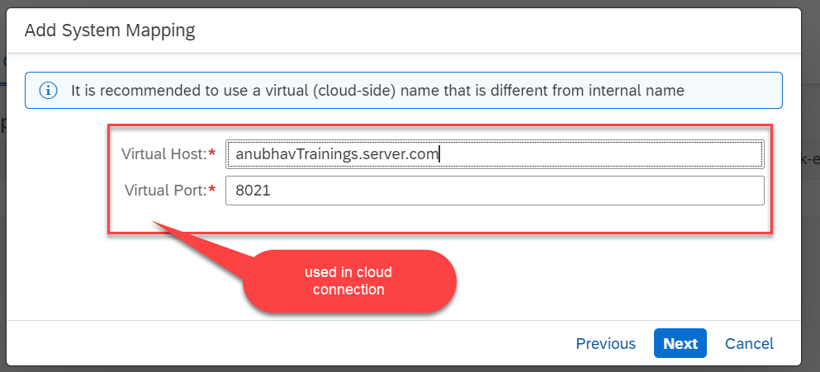
Cloud connector continue…
Step 6: Connect on-premise system to cloud using SCC

Slide 13
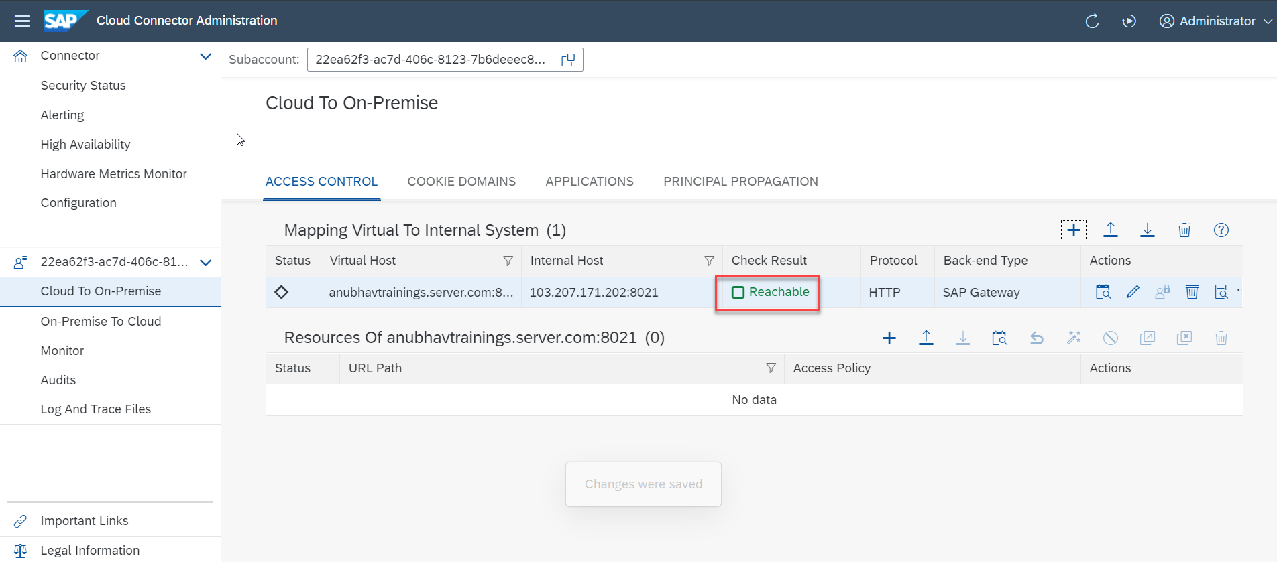
Cloud connector completed
We have Done with Connect , now we are now successfully connected to cloud using SCC.

Slide 14
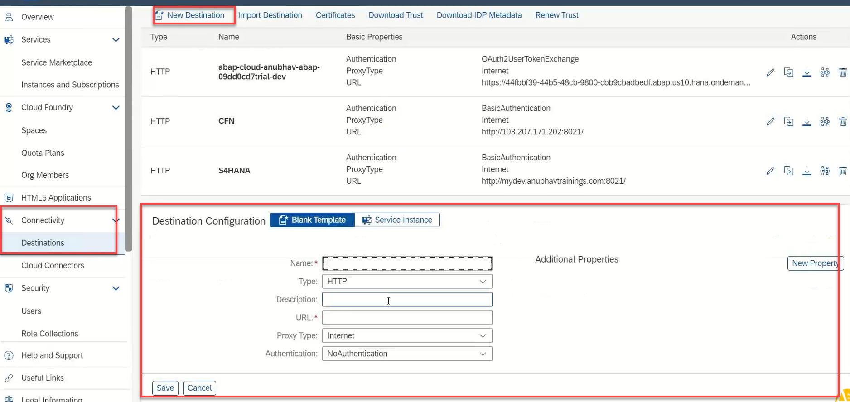
Creating the Destination in BTP
Now once the cloud connector setup is done. We need to create a destination in the Business Technology Platform (BTP) to assess our SAP system in the BAS.
There are two ways to create a destination in BTP:
Create a destination directly in BTP (Not Recommended)
Creating the destination inside the BAS (Recommended)
To create a destination directly in BTP
Go to the Connectivity > Destinations and here click on New Destination
Then a new Destination Configuration will open.
Enter all the details of the system and press save.
After that check the connection with destination.
This way of creating destination is not recommended because in this method, to assess the odata service in the fiori application some additional properties are required. Adding that properties is a little tricky and can lead to error.
That’s why we will not use this method.

Slide 15
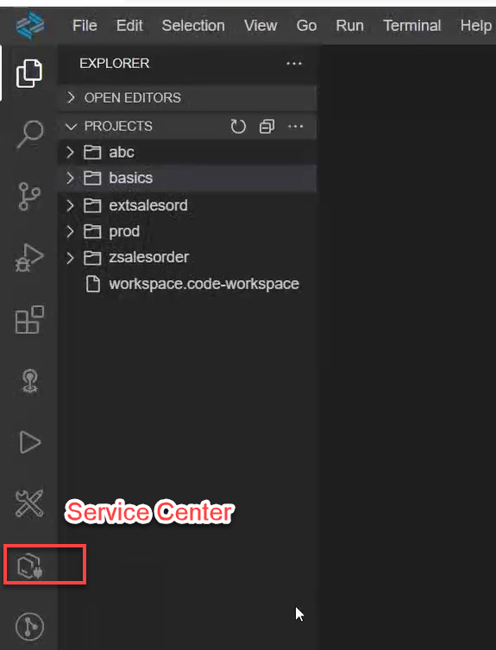
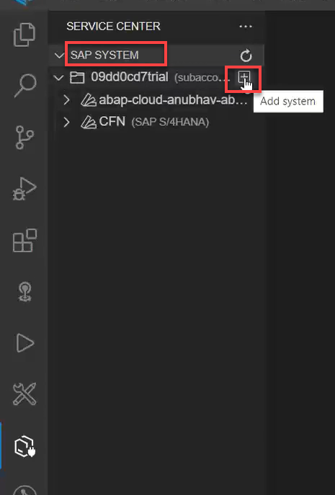
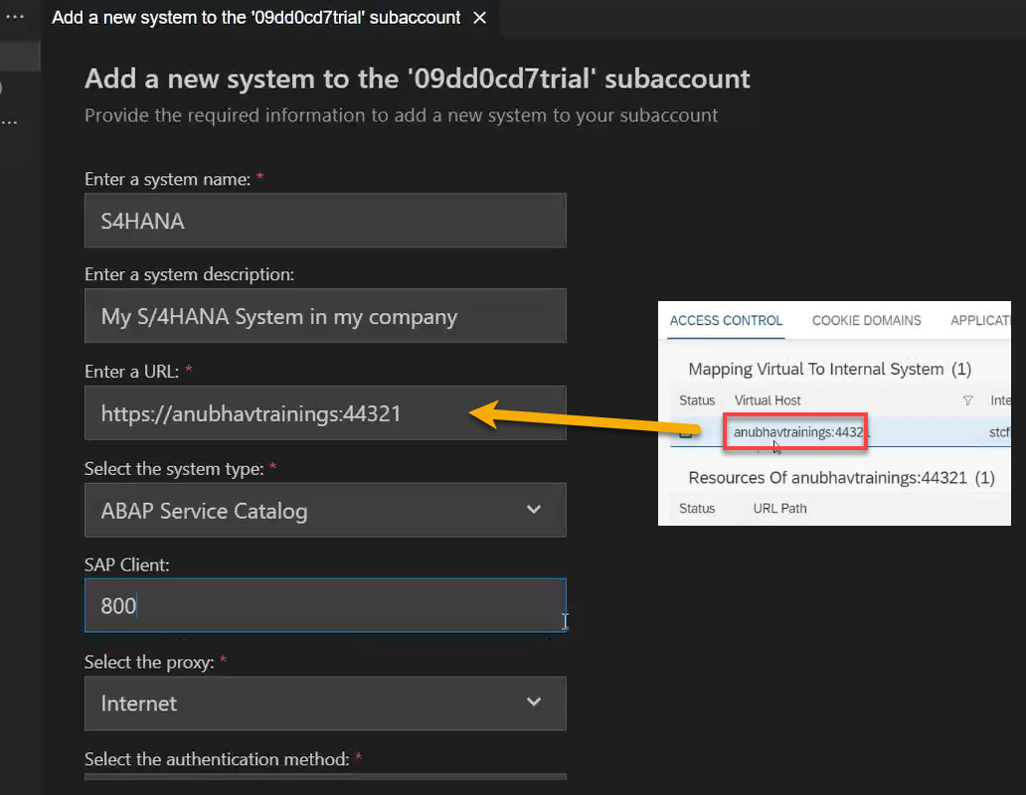
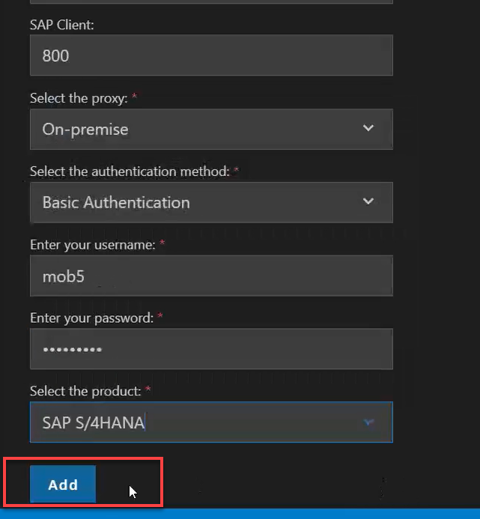
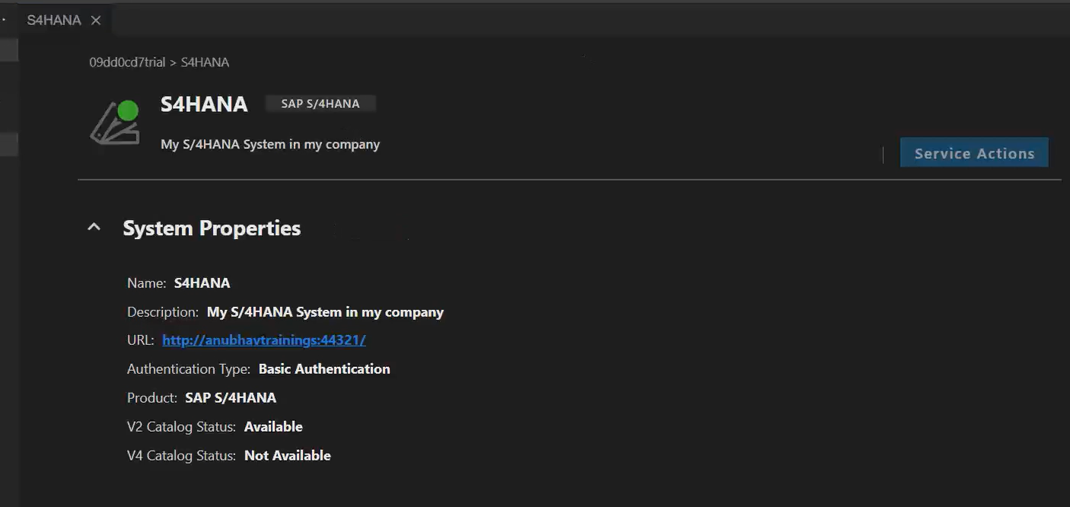
Creating Destination Inside BAS
To create the destination directly using BAS follow the step:
Start your BAS tool and in that go to the service center in the left side bar.
Then under the SAP SYSTEM section choose your subaccount and click on plus button +
Fill the details as shown and press Add. You can create a new Project for the template to test this destination.

Slide 16
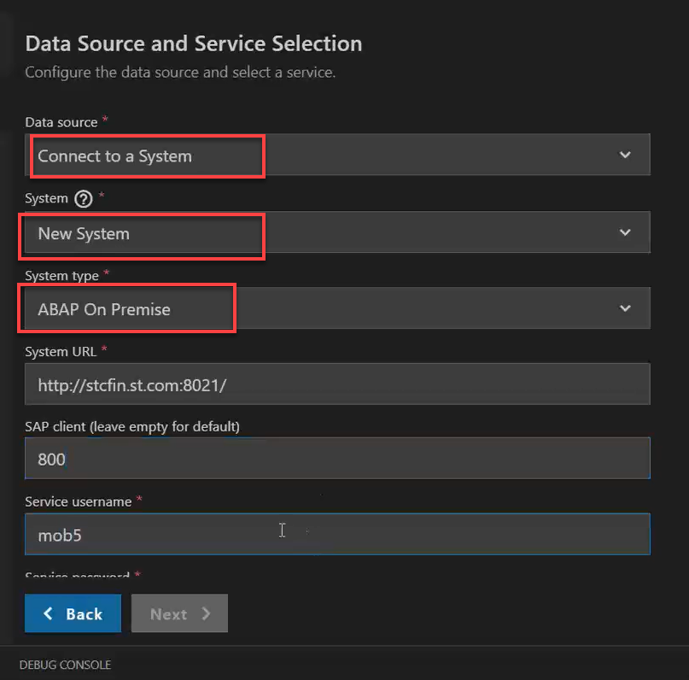
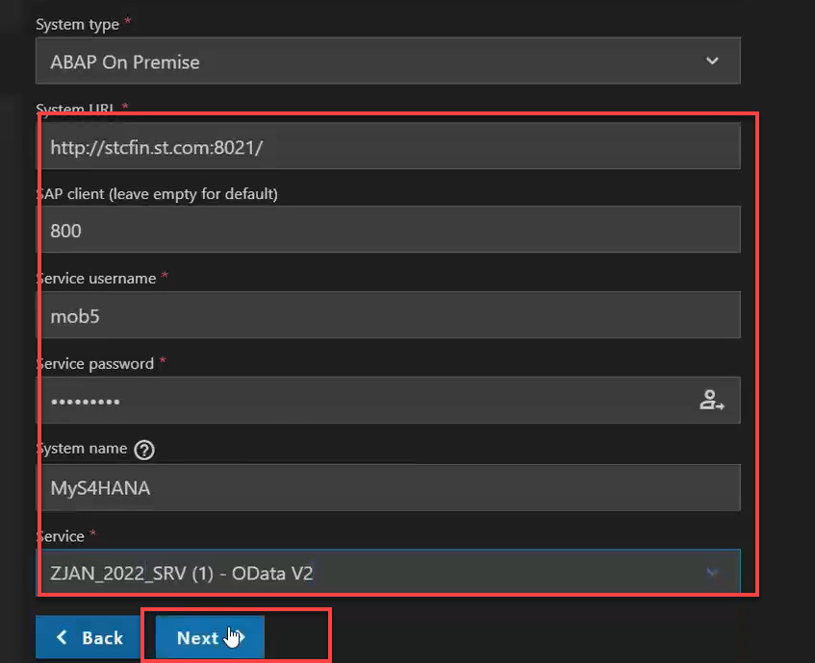
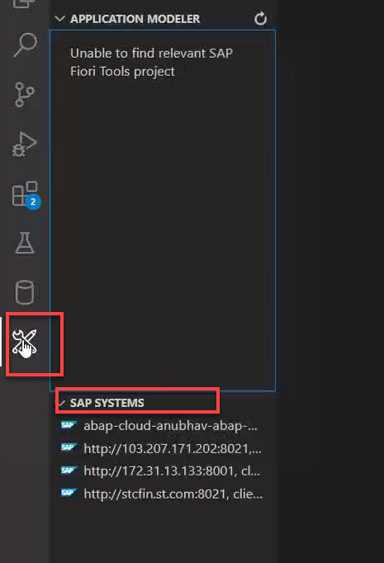
Connecting system to the VSCode
Now if we want to connect our system to the vscode we don’t need the Cloud Connector, because the VS code is already running in our local system and in our local system we can use the VPN to access our SAP System.
So to connect vs code to the system:
Open application generator using the command palette.
Create any type of project (let’s select the master detail).
In the Data Sources as Connect to a System
In system select New System and system type as ABAP on Premise
And then Enter the system detail.
Then complete the project setup.
After that you can see the created system in the Fiori Tools option in the left side bar, under the SAP SYSTEM.

Slide 17
CORS – Cross Origin Resource Sharing
It is a browser security policy which prevent us connecting to a domain while running web page on a different domain.
Browser
https://localhost:8080
https://localhost:8080/sap/opu/data
S
Proxy
Facebook.com
Google.com
Another Server
http://103.207.171.202:8021/sap/opu/odata/sap/ZOCT_ODATA_SRV/$metadata
https://www.npmjs.com/package/@sap/ux-ui5-tooling

Slide 18
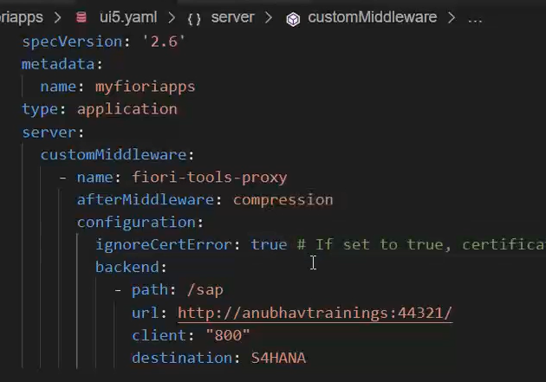
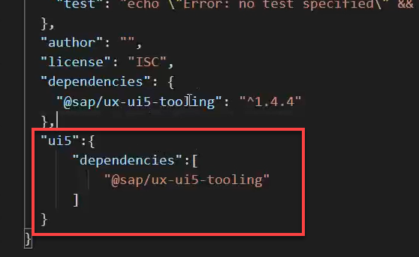
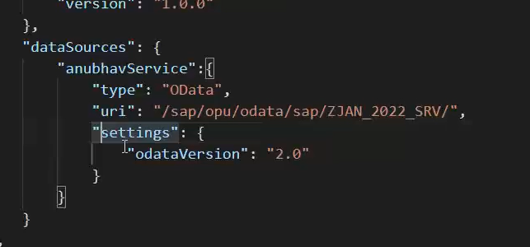
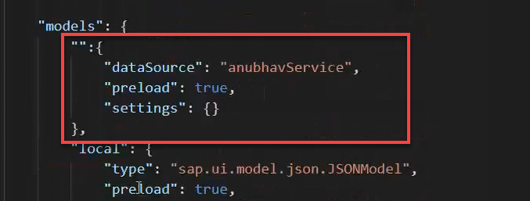
Integrating OData in Fiori App
Before we start OData integration in our fiori project we need have to check that, we have added the package.json and ui5.yaml file in our project, if the we haven’t add then run these commands in the terminal to added these files:
npm init
ui5 init
Now we have the required file in the project, we can proceed the integration.
Go to ui5.yaml file and add the middleware code (given in the link) to the file and save it.
Add the dependency of sap/ux-ui5-tooling to the project using the command: npm install @sap/ux-ui5-tooling
Now add the ui5 section in the package.json file to specify the dependencies related to ui5.
Now go to the manifest.json file we have to add a dataSource under the sap.app section and then create a default model to consume the service in UI.

Slide 19
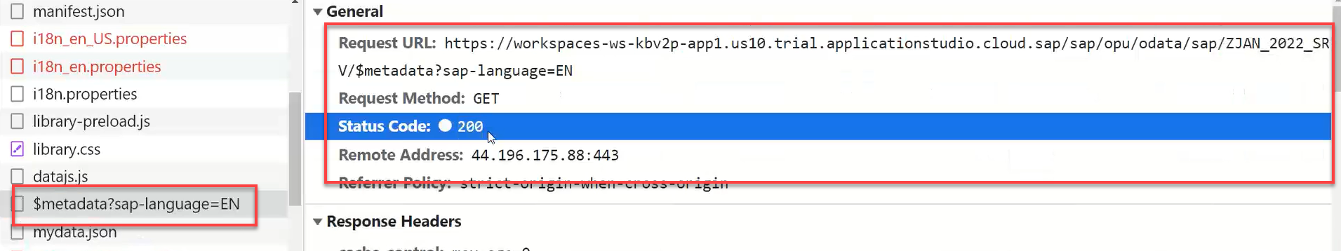
Hands – on: Consume OData service
Follow the steps given in the previous slide to configure the fiori app in BAS to consume the Odata service.
Once the configuration is complete the app will call the metadata of the application which we can check in the Network tab in browser.
Code Link:-
ui5.yaml
package.json
manifest.json

Slide 20
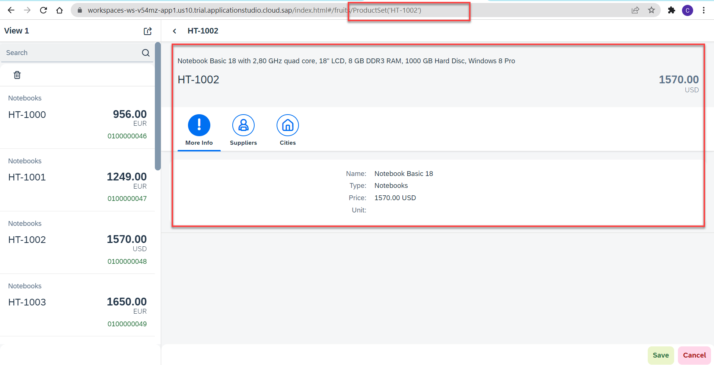
Hands – on: Binding the app with odata
Now to get the data into the application we have to change the binding of the application. Initially the app is bind to the fruits data, so we have to bind it form the OData properties.
We also have to change the Route Match Handler (herculis) code in the View2 controller.
We have to add the growing property to the list to support pagination.
And we also have to change the search function to support the filter on the CATEGORY.
Code Link:-
View1.view.xml
View1.controller.js
View2.view.xml
View2.controller.js
moreInfo.fragment.xml

Slide 21
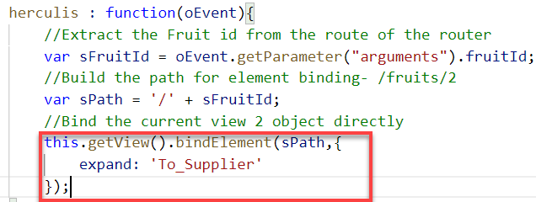
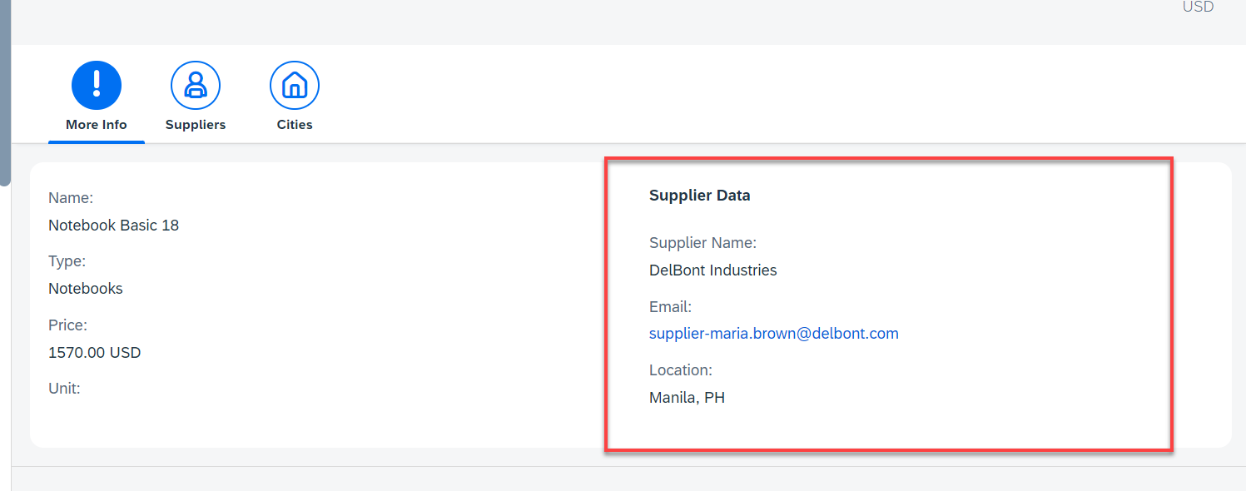
Hands – on: Getting the Associated Data
Now we want load the associated data on the UI. To do that we will create a new form in the moreInfo Fragment and in that form we will load the Supplier data of the product.
We will also have to make some changes in the Binding of the View2 to load the dependent data.
Code Link:-
View2.controller.js
moreInfo.fragment.xml

Slide 22
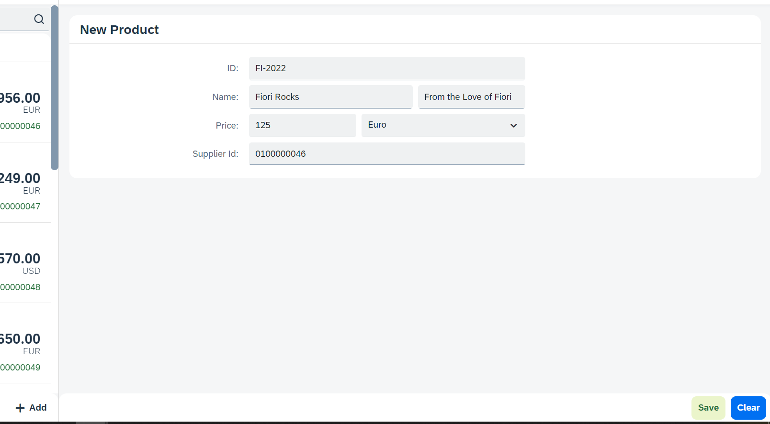
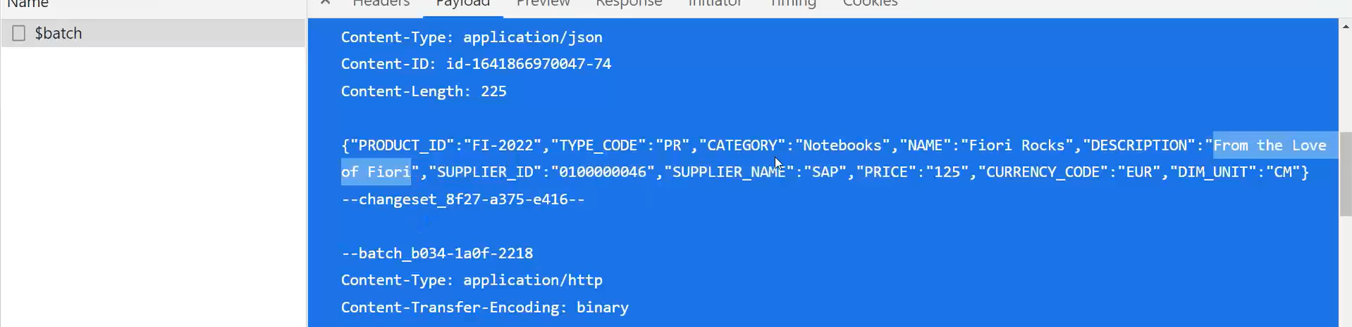
Hands – on: Making POST call from UI
Now we will add a new view named as Add. In this view will add a simple form to enter the product details and then on press of the Save a new Product will be created in the backend.
We will also add a Clear button to clear the form.
Code Link:
View1.view.xml
View1.controller.js
Add.view.xml
Add.controller.js
manifest.json

Slide 23
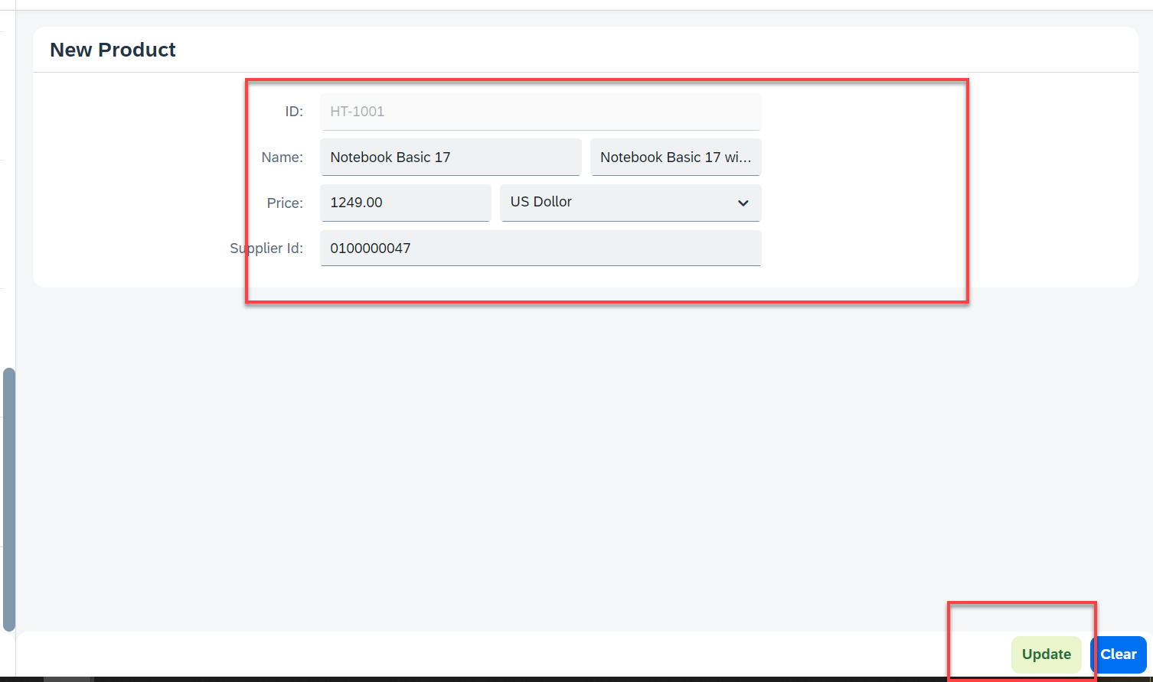
Hands – on: Making Update call form UI
Now will add a functionality to update a Record form the backed. But before that we will have to load the record in the form and then we will update that recode and save it.
Code Links:-
Add.view.xml
Add.controller.js

Slide 24
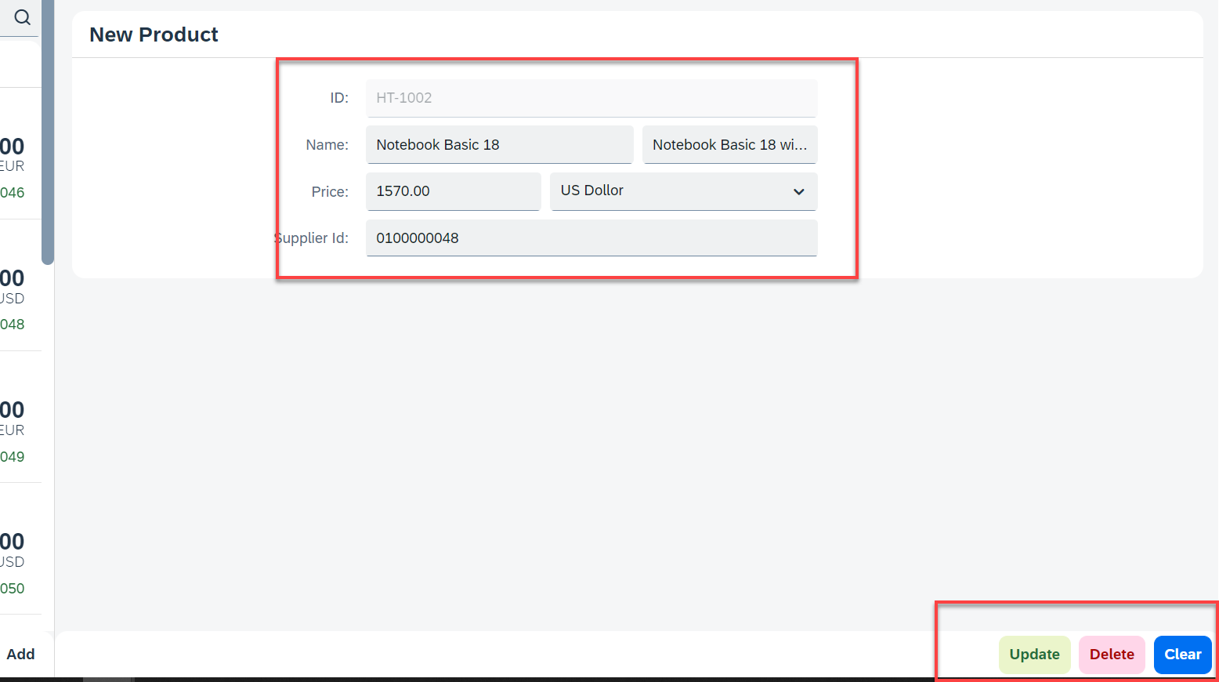
Hands – on: Making Delete call from UI
Now we want to delete a selected record form the UI. To do that we have to make a delete button in the UI and on press of that delete button the record will be deleted form the backend.
Code Links:-
Add.view.xml
Add.controller.js

Slide 25
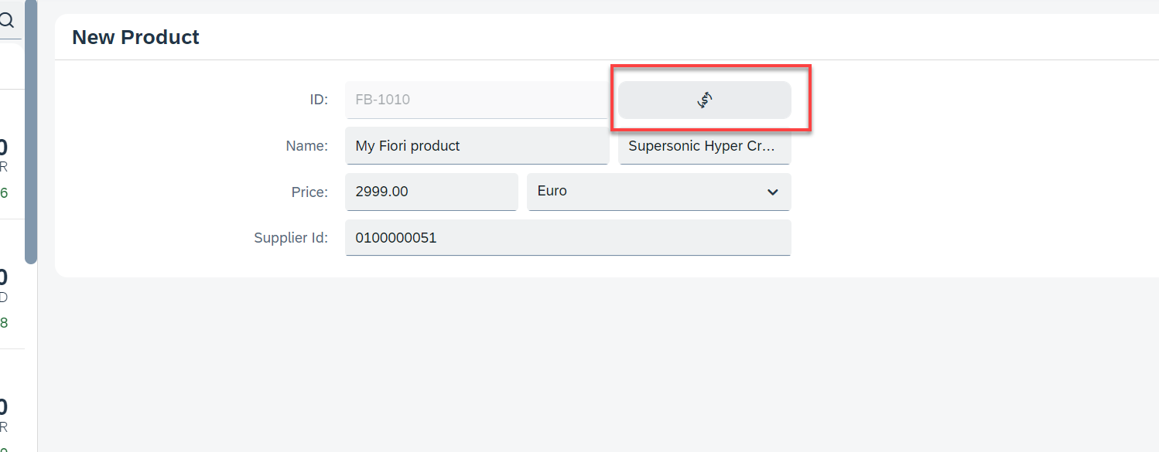
Hands – on: Calling the Function Import
Now load the most expensive data on the Add View. To do that we will add a button next to the Product ID field and on press of that button we will make a call to the Most Expensive Products function which we have created. And then load the data into the form.
Code Link:-
Add.view.xml
Add.controller.js

Slide 26
Delivering Fiori Apps
Currently the Application we have developed is in our local system (VS Code or BAS). Now we want this app to be accessible by other people in our company, to do that we have to deploy this application to our ABAP environment or cloud platform where it can be accessed by others.
BAS/VS Code
GitHub
Development Team
destination
SCC
DEV
QLT
PROD
BSP App
BSP App
BSP App

Slide 27







Delivering Fiori Apps
2
ui5 build
Development Environment
(BAS, VSCode, etc.)
1
git push
dist
GitHub Repository
3
npm run deploy-config
Developer
deployment configuration
End Users
4
npm run deploy
ABAP Repository
PROD (P)
DEV
Quality(Q)
Transport Request
Transport Request
Admin
Launchpad and Launchpad Designer

Slide 28
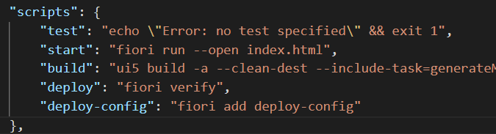
Adding deployment Configuration to App
Steps to configure the Application to deploy the Application on ABAP Environment.
Open the terminal in BAS or VS Code and go to your project folder.
Open terminal in you project folder.
Write command ui5 build or npm run build and press enter to build your project it will create a dist folder.
Now write command npx fiori add deploy-config to configure the project for deployment.
Select a target ABAP system … http://103.207.171.202 in your case your hostname will come in this step.
Enter the ABAP system client number …
Enter a username …
Enter a password …
Enter an application name …
Enter a description for the application …
Enter a package for the deployed application … $TMP
Now to deploy the application to the ABAP repository we use the command npm run deploy.

Slide 29
Delivering Fiori Apps
Currently the Application we have developed is in our local system (VS Code or BAS). Now we want this app to be accessible by other people in our company, to do that we have to deploy this application to our ABAP environment or cloud platform where it can be accessed by others.
BAS/VS Code
GitHub
Development Team
destination
SCC
DEV
QLT
PROD
BSP App
BSP App
BSP App

Slide 31
Delivering Fiori Apps
2
ui5 build
Development Environment
(BAS, VSCode, etc.)
1
git push
dist
GitHub Repository
3
npm run deploy-config
Developer
deployment configuration
End Users
4
npm run deploy
ABAP Repository
PROD (P)
DEV
Quality(Q)
Transport Request
Transport Request
Admin
Launchpad and Launchpad Designer

Slide 32
Adding deployment Configuration to App
Steps to configure the Application to deploy the Application on ABAP Environment.
Open the terminal in BAS or VS Code and go to your project folder.
Open terminal in you project folder.
Write command ui5 build or npm run build and press enter to build your project it will create a dist folder.
Now write command npx fiori add deploy-config to configure the project for deployment.
Select a target ABAP system … http://103.207.171.202 in your case your hostname will come in this step.
Enter the ABAP system client number …
Enter a username …
Enter a password …
Enter an application name …
Enter a description for the application …
Enter a package for the deployed application … $TMP
Now to deploy the application to the ABAP repository we use the command npm run deploy.

Slide 33

Introduction to Git and GitHub
Git is a version control system that lets you manage and keep track of your source code history.
GitHub is a cloud-based hosting service that lets you manage Git repositories.
Git HUB is a central repository to store all the code. Git is a distributed repository management system, which allows development teams to organize and sync their development code.
Use Case- I am working as a Fiori Developer in an MNC and I want to share my code with fellow developers, currently I am downloading the zip/tar file and sharing over email.
This way we will have piles of emails in our account,
especially when we work in a team of size 40 developers it becomes very hard to sync changes.
There is version control. Last night my app was stable, I made some changes this morning which messed up the whole project. I some how pray to god that can you please take me in past.
In a big team, many developers touching each other’s code and it’s hard to blame someone who disrupt the code.
It is also very hard to merge changes when done in same file.
As a developer, I am using BAS today, tomorrow I will use VS Code and next day Web IDE and very next week Atom. How can I easily port my code between these tools.
You can install git in local machine using below link (however, it comes along with all dev tools)
https://git-scm.com/downloads

Slide 34

How GitHub Works and commands in Git
We will see some important commands related to Git and will see how GitHub works.
Some important commands to use git.
git Init: It is used to initialize a new Git Repository in the system.
git add <filename>: It is used to stage the changes of the file to git repository. We can use ‘git add .’ to stage the changes of all files.
git commit: It is used to commit all the staged changes with a message.
git reset hard: Discard all the staged changes and discard the changes in all the files.
git push: It is used to push all the changes in the git repository.
git pull: It is used to pull the new changes made by other users in the project.
git status: It is used to check the status
git clone: It is used to clone a repository.
git remote add <repo URL>: Add a local repository to a remote repository.
Fiori Project (or any kind of project)
User (Anubhav)
But how all users will work on the project at a same time?
Anubhav’s local machine
Here GitHub comes into picture
Users which are working on the different parts of the same project on different Platforms (BAS, VS Code, Web IDE)
Project Repository
The project will be kept in a repository in the GitHub

Slide 36





Steps to Create a new git Repository
Step by Step process to create a git repository in GitHub. First of all you must have a GitHub account, if not then go to this link https://github.com/signup?source=login and create a new Account.
Step 1: Click on the plus button in the top right corner of the screen and select ‘New Repository’.
Step 2: Type a short, memorable name for your repository. And give a description (optional).
Step 3: Select the type of repository. Public or Private
Step 4: Set how you want to Initialize the repository.
Step 5: Click on Create Repository. Your Repository will be created.
Repository Created Successfully

Slide 37
Adding project to git repository
Project on Local System
1
git init
Initialize a git repo
2
git add .
Stage all the changes
3
git commit –m “message”
git pull
Once the project is connected to git repo then we just use the git pull and git push commands to get the new changes and send our changes
Stage all the changes
git push
5
git add remote <repo URL>
Add the remote branch
GitHub Repository
git push
5
Clone repository for the first time in system
git clone <repo URL>
GitHub Repository

Slide 38

Fiori Launchpad
SAP Fiori Launchpad is a single access point for all the Applications in S/4HANA. Is available fiori frontend server once Fiori is installed in your SAP System.
The SAP Fiori launchpad is a shell that hosts SAP Fiori apps, and provides the apps with services such as navigation, personalization, embedded support, and application configuration.
The launchpad is the entry point to SAP Fiori apps on mobile and desktop devices. The launchpad displays a home page with tiles.
Each tile represents a business application that the user can launch. Tiles can also display live status indicators, such as the number of open tasks.
The launchpad is role-based. In other words, the user’s role determines which app tiles are shown.
Launchpad comes with Launchpad Designer (LPD), which allows developer/consultant to configure access to the apps as a Tile.
The TCode to access:
Launchpad: /N/UI2/FLP
Launchpad Designer: /n/UI2/FLPD_CONF

Slide 39
Why we require Launchpad
Just imagine, if my co. have developed 500 Apps in last Quarter, These 500 apps have got 500 URLs to access the app. As a end user, you would face below challenges
Finding URL for each app is a challenge
Making sure that you are right person to access app – Security
Also you should only be able to see apps which you are allowed to access
SAP Portal is now deprecated, what options do we have to access all functionality of ERP
Type of Fiori App Implementation
There are two types of Fiori App Implementations: Standard Apps and Customized Apps.
Standard Applications
Customized Apps
Implementation of those business apps, which are released by SAP
These are categorized as Transnational, Fact-sheets and Analytical apps etc.
As per business requirement, a complete custom fiori app can be implemented.
Customized App is been hosted on SAP-Fiori server (front-end system).
It integrates with SAP or Non-SAP system.

Slide 40

Fiori Launchpad Access
The service which is used by Launchpad to run
/UI2/INTEROP – This service controls navigation from tile to the Application
/UI2/PAGE_BUILDER_PERS – Launchpad personalization, Used to load all the tiles, groups of users, controls the loading of launchpad content for our users.
Trouble shooting:
The service is not even registered
The service is not even activate
You may not have authorization to access this service.

Slide 41
Basic Terms related to the Launchpad
Catalog – A Collection of all the Tiles, Each tile represent precisely one Application. We create catalog to package all tiles together according to team, functional area, application component, functionality, area of responsibility…
Tile – a square box which provides entry point for an app, it consists of 2 parts,
Tile Properties – title, subtitle, icon, ..
Intent - Semantic Object + Action
Semantic Object – The business object which is involved in the activity. Area of interest. E.g. SalesOrder, PurchaseOrder, OutboundDelivery, Customer, Vendor, Sales,..
Action – Define the purpose of our Fiori Application. Indicative of the Activity which we want to perform on Business object. E.g. Create, Change, Manage, Track, Maintain, Execute, Analyze
Intent ➔ SalesOrder-manage, OutboundDelivery-track
Note: Every application in entire system has unique intent.
3. Target Mapping – Maps the intent with the actual Fiori App, WeBGUI, Tcode, Webdynpro App.
4. Group – Is used to group tiles logically from business point of view, We never create tiles in group. We reference tiles in the group from catalog.
5. Role – A user will be granted a role and inside the role we will have the catalog and the group.
intent
Tile
Tile 1
Fiori App
Tile
Tile 2
Target Mapping

Slide 42

Relationship between Front-End Components

Slide 43

Types of Fiori Apps
SAP UI5 and Fiori Development
ABAP on HANA Cum S.4HANA CDS
Fiori Advance and Security
Types of Fiori Apps
Fiori Elements
Transactional Fiori Apps
Fact Sheet / Smart Filter
Analytical Fiori Apps
Free Style Fiori App
Display Data in Smart table
Query Browser Tile
Master Details
SAP Analytic List Page
Overview Pages
Worklist
There 2 ways to create these apps
Using CDS View based annotations
SAP BAS/VS Code annotation Editor
KPI Modeler
BOPF Based Apps
(CDS view)
Free Style Analytic App
www.anubhavtrainings.com

Slide 44



Data Model
www.anubhavtrainings.com

Slide 45
Fiori = UX Consistency
UX consistency
▪ Increases adoption of your app
▪ Improves business user productivity
▪ Decreases training time
▪ Improves data quality
▪ Enhances user satisfaction
SAP Fiori elements provides standard floorplans and uses metadata to streamline and accelerate developing SAPUI5 applications.
SAP Fiori elements
▪ Delivers enterprise-ready SAPUI5 apps based on
stable, optimized, out-of-the-box UI code
▪ Boosts developer efficiency by scaling development
and maintenance in a cost-efficient way
▪ Provides a centrally managed, consistent UX
complying with the latest SAP Fiori design
▪ Ensures upgrade stability and forward compatibility
▪ Allows extensibility of standard floorplans with custom
controls and logic

Slide 46

Free Style v/s Fiori Elements Apps

Slide 47

Big Picture – Architecture

Slide 48
Annotations
Annotations are additional metadata and provide abstract definitions of data semantics. These abstract definitions are stored in vocabularies from OData and SAP. SAP Fiori elements understand the annotations and generates the UI based on them.
CDS View Annotations
XML Annotations
Annotations which are coding in ABAP system.
Require experience in ABAP on HANA and done by an ABAP or S/4HANA Consultants
CDS annotations follow the lifecycle of your OData
Service.
Due to different release cycles, some new annotations
might be available later in ABAP CDS.
More suitable if we use frameworks like RAP, & BOPF to build end to end applications
Project will be coupled with OData built on CDS hence we cannot test application if the service is down.
Easy to code and can be modularized with metadata extensions in CDS.
Use ADT tool to code the same.
Coded inside the annotations.xml file inside a Fiori Application
Require understanding of XML in general and knowledge of annotations
XML annotations follow the lifecycle of your app (local project)
With latest UI5 release, we can use new features
Suitable if we use SEGW based services, Or other frameworks which does not support the annotations.
UI projects are decoupled from the CDS and services and can be tested and transported independently.
Easy to work with the help of annotation modeler extension pack
Use BAS or VS Code to develop same.

Slide 49


Creating Fiori App using Template in VS code
Before we start generating application in VS code, we need to verify that Fiori Tools are installed in our system or not. To do that we need to install an extension pack in VS code, which is SAP Fiori Tools – Extension Pack.
Once the installation of extension pack is completed, we can follow the same steps which are specified in the previous slide. In which we have generated the application using template in BAS.
When we open the Template Wizard in VS Code then, we will see a similar screen which we have seen in the BAS.

Slide 50
Fiori Elements - List Report Application
The list report offers powerful features for finding and acting on relevant data sets. It is often used as an entry point for navigating to the item details, which are usually shown on an object page.
List Report
Object Page

Slide 51


Components of an Object Page
www.anubhavtrainings.com

Slide 52

Fiori Extension Pack in VS Code
www.anubhavtrainings.com

Slide 53






















Slide 54





























Slide 56
Title
Content

Slide 57

End of Day 16

Slide 58

Questions

Slide 59

Sakshi Gupta

Slide 60


We’re committed to empower you to be
Most Desirable Resource
through powerful training solutions.
We build the workforce of the future.
250+
Corporate Clients
30,000+
Learners Trained
25000+
Learners Placed
FREE WEBINARS
Sign up for free webinars with industry experts every fortnight!
Enroll Now!
Contact us today!
https://anubhavtrainings.com/

Slide 61




More from AnubhavTrainings.com

Slide 62
Title
Content

